Slide 1
Team Nox Presents:

Slide 2
LUMOS — Humanoid Home Assistant
Robot picture
A voice-first AI assistant that doesn't just answer — it acts.
Built on a Raspberry Pi Zero W with microphone, Bluetooth speaker, AI/LLM backends, and an optional phone/browser interface. LUMOS transforms the smart home assistant from a command executor into a true personal AI agent.

Slide 3
Smart Assistants Are Still Too Limited
Traditional smart assistants made voice interaction mainstream — but the experience is still locked to predefined capabilities, skills, and a manufacturer's ecosystem. You can ask "Set a timer" or "Play music," but when the request gets complicated, users reach for their phone.
Problem:
Restricted to supported skills and integrations
Many tasks require specific commands or services
Users must often phrase requests in ways the assistant understands
Traditional Assistant
USER → FIXED COMMAND → FIXED CAPABILITY → RESPONSE
Modern AI
USER → NATURAL INTENT → REASONING → TOOLS → ACTION
The real opportunity
Today's LLMs can understand natural language, reason across a request, use tools, access information, and perform multi-step tasks.

Slide 4
Alexa LUMOS
Alexa
LUMOS
Not a true LLM-first assistant
Limited to Amazon’s ecosystem
Limited personalization
System prompt cannot be changed
Limited conversation
ChatGPT API
User flexibility through open source
Multipurpose approach through tools
Backup of previous conversation
Long distance conversation through IoT

Slide 5
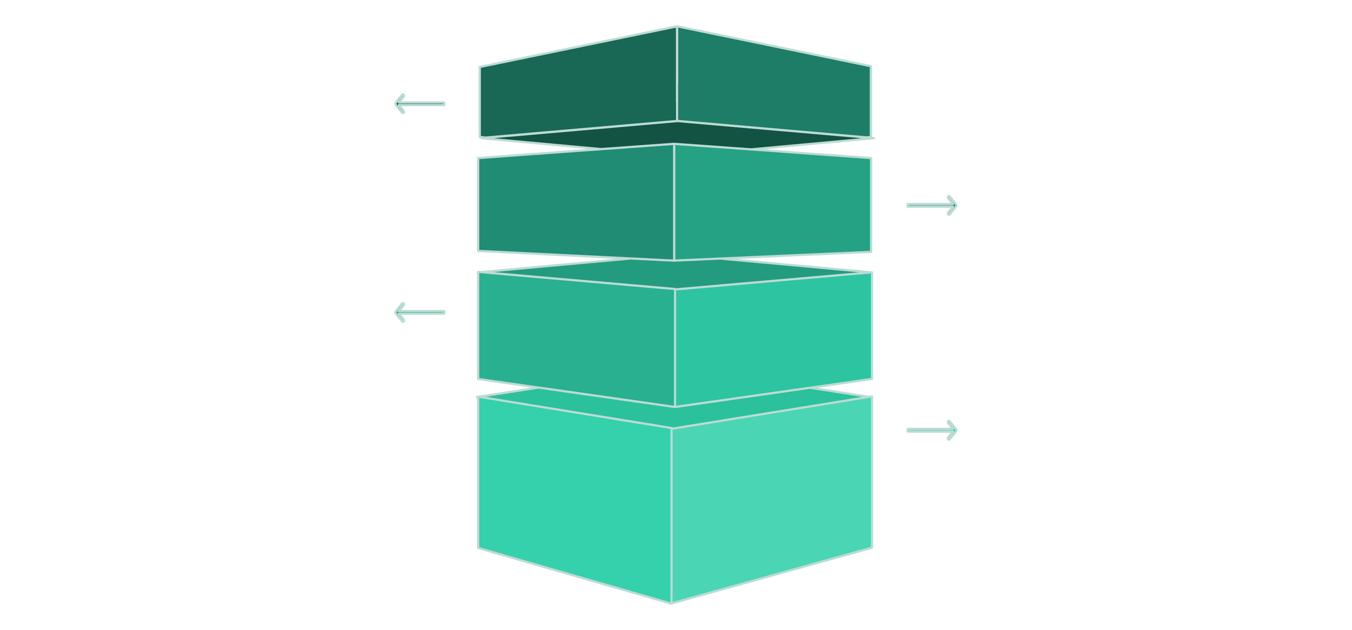
Meet LUMOS
LUMOS is a Raspberry Pi-based AI home assistant designed to listen, understand, act, and respond. One small device, one natural interface, many AI capabilities.
Listen Naturally
User speaks to LUMOS in normal language.
Select & Execute
Demo Flow
LLM chooses and runs the required tool or action.
“LUMOS, remember my project deadline."
Recognize & Route
→ Understands the request
→ Uses the memory system
→ Stores the information
→ Confirms through voice
AI transcribes and routes request to the LLM.
Speak Result
LUMOS vocalizes the outcome back to the user.
This single interaction demonstrates the core idea: natural language → AI reasoning → tool execution → response.
LUMOS already handles: questions and conversation, web-aware information, music, reminders, persistent memory, image generation, AI music generation, Python execution, file management, GitHub operations, YouTube, HTML hosting, and automated multi-step tasks. It uses its set of tools to achieve what is already possible, like asking for an image of a cat, LUMOS does not have access to cat images, but it can make an API request using one of the tools to get the image.

Slide 6

An AI Brain Inside a Small Home Device
LUMOS's architecture is built in four interconnected layers, each supporting multiple providers, keeping the system flexible and future-proof.
Speech Recognition
LLM Layer
Google Speech Recognition and Whisper python library accurate voice input from any distance.
OpenRouter and Google Gemini for web-aware AI model-flexible architecture, not locked to one provider.
Text-to-Speech
Tool Layer
Cartesia natural, expressive voice output for every response in a melodious voice.
Music, memory, reminders, files, Python, GitHub, YouTube, image generation, web services, HTML hosting Tools to allow LUMOS to achieve goals that aren’t possible normally.
The innovation isn't putting AI inside a speaker, it's connecting an LLM to an expandable tool ecosystem through a dedicated voice-first device.

Slide 7

Screeshots and video of model
LUMOS Is Already More Than a Concept
Current Prototype Capabilities
Voice & AI Core
Wake-word detection, speech-to-text, AI-generated speech, multiple LLM backends, model switching, web-aware AI mode.
Assistant Features
Alarms, reminders, persistent memory, time queries, music search, playback, playlists, volume control, AI music generation.
Creation & Dev Tools
Image generation, Python execution, file creation/editing, HTML hosting, GitHub search, repo cloning, code operations.

Slide 8



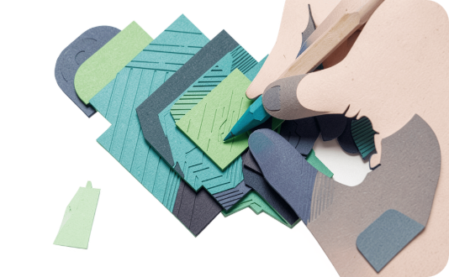
Who Is LUMOS For?
LUMOS serves a wide range of users, from families needing everyday help to developers automating complex workflows. The common thread: natural voice interaction that actually gets things done.
🏠 Families
🎓 Students
💻 Developers & Makers
🎨 Creators
“LUMOS, remind me to call Dad at 8." Reminders, information, music, and everyday assistance for the whole household.
“LUMOS, explain this concept." Research, questions, reminders, coding help, and productivity support.
“LUMOS, generate an image for my project." Image generation, AI music, and content creation on demand.
“LUMOS clone this GitHub repository." GitHub, files, Python, and development workflows — hands-free.

Slide 9

Quantify expected benefits, time saved, cost reduction, environmental impact, lives improved, efficiency gained, SDG alignment, measurable outcomes.
Turning a Smart Speaker Into a Personal AI System
1
Device
One Raspberry Pi replaces multiple apps and screens for supported tasks.
10+
Tool Categories
Music, memory, files, GitHub, Python, web, YouTube, images, automation, and more.
3
AI Backends
OpenRouter, Groq, and Chute — switch models without changing hardware.
0
Ecosystem Lock-in
Built from open software components that can be changed and extended.
LUMOS moves the smart-home experience from Command → Response toward Intent → Reasoning → Action. Productivity improves because users describe tasks naturally. Accessibility increases through voice-first interaction. And the platform evolves — new AI models, tools, and integrations — without redesigning the physical product.

Slide 10



From Prototype to Personal AI Platform
EMO's roadmap is structured in three clear phases, each building on the last — from a working prototype to a full personal AI platform.
Phase 1 — Prototype
Phase 2 — Product
Phase 3 — Platform
Raspberry Pi + microphone + Bluetooth speaker. Goal: reliable voice interaction and core AI capabilities. ✅ Complete
Custom enclosure, improved microphone, better audio, simplified setup. Goal: make EMO usable as an everyday home device.
Smart-home integrations, sensors, local AI, user profiles, custom automations, and a developer tool ecosystem.
Possible Business Model
Scalability
Hardware: Sell an affordable EMO device
Software: Optional premium AI/model features
Integrations: Home automation and specialized deployments
Developer Platform: Users create and add their own EMO tools
EMO's architecture scales through software — more models, more tools, more APIs, more devices, and eventually full smart-home automation. The same software concept can move to more powerful Raspberry Pi hardware or custom hardware over time.

Slide 11


The Future of Home Assistants Isn't More Commands
Alexa helped introduce millions of people to talking to computers. The next step is different. An assistant shouldn't just recognize what you said — it should understand what you mean, know which tools it needs, and actually do the work.
Technical Feasibility
Operational Requirements
d
Electricity, Wi-Fi connection, Raspberry Pi, Wires, Speakers, Mic, Concept of IoT
* **Technical Feasibility** – Can we build it?
* **Operational Requirements** – What does it need to work?
* **Risks** – What can go wrong?
* **Future Enhancements** – What can we improve later?
* **Scalability** – Can it be used in many places?
Breach Potential
Future Enchancements
Different outcomes as compared expectations, Technical Glitch
Speak → AI → Action → Voice. No ecosystem lock-in. Built from components you can change.
Smart speaker: "Here are the things I was designed to do." EMO: "Tell me what you're trying to accomplish."

Slide 12
USP, comparison with existing solutions, innovation, IP potential, future scope, why your solution stands out.

Slide 13
Backbone of LUMOS
Team Roles
Mentor
Arnav Bansal : Project Idea and working
Chirag Jain : Hardware and Presentations
Kanish Jain : Editor and Helping Hand
Maulik Patolia,
the one who guided and enlightened us throughout this project
Contact Details
Future vision
Email ID : maulikpatolia007@gmail.com
chirag.vijendra944@gmail.com
GitHub:
Id : @cyborgchirag
The aim of Nox is just to create AI models which can integrate sustainability, and user comfort. In this revolutionizing world of technology, Nox tries that every problem has an innovative and pocket friendly solution. LUMOS is the first step towards it.

